Slide 1

APT 3010
Intro. To Artificial Intelligence.
Career Path.
Fall Semester-2022.
||Fredrick Michael Ogore||fogore@usiu.ac.ke|| Cell-No:0717105568||

Slide 2
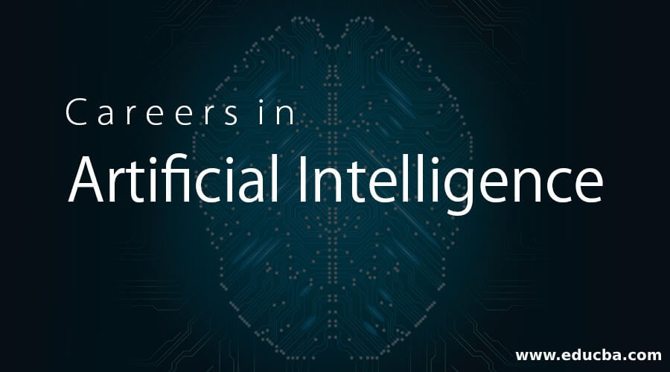
Notes:
Part1-Introduction

Slide 3
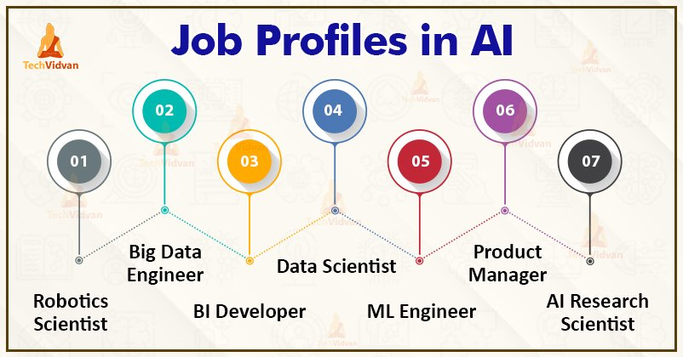
Notes:
Part1-Introduction

Slide 4
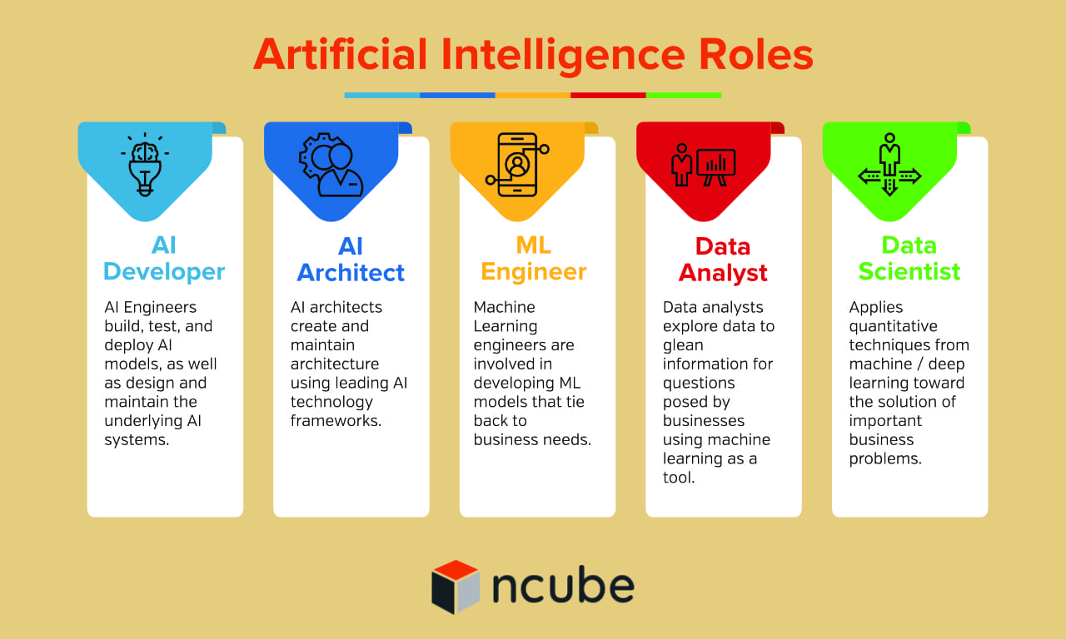
Notes:
Part1-Introduction

Slide 5
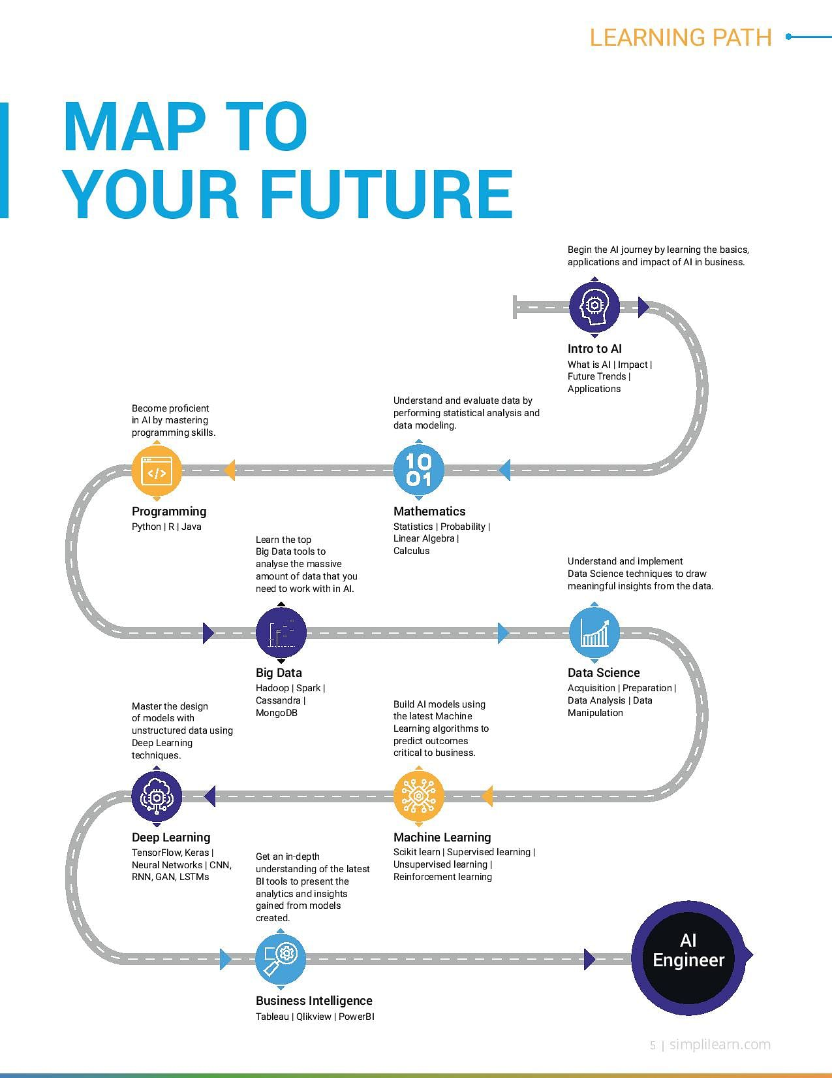
Notes:
Part1-Introduction

Slide 6
What is AI?
Artificial intelligence is all around us, even in places you may not realize.
From music preferences to home appliances and healthcare, the power of AI is far reaching.
Notes:
Part1-Introduction

Slide 7
What is AI?
“AI refers to the simulation of human intelligence in machines that are programmed to think like humans and mimic their actions.
The term may also be applied to any machine that exhibits traits associated with a human mind such as learning or problem-solving.”

Slide 8
Examples of AI.
Smart assistants like Siri and Alexa
Pandora and Netflix, which provide personalized song and entertainment recommendations
Chatbots.
Robotic vacuum cleaners.
Self-driving vehicles.
Facial recognition software.

Slide 9
What Does an AI Professional Do?
Since artificial intelligence is an increasingly widespread and growing form of technology, professionals who specialize in AI are needed now more than ever.
The good news is that the AI professional field is full of different career opportunities, which means you can take on different roles and responsibilities depending upon the position, your experience and your interests.

Slide 10
Professional AI Skills in Demand for 2022.
If you’re looking to enter the professional world of AI, it’s important to make sure you have the right skills, which will set you apart from other candidates and help you land the perfect position.
First, competencies with calculus and linear algebra are extremely important.
Also, if you’re interested in AI, you should have some knowledge and experience in at least one of the following programming languages:
    Python
    C/C++
    MATLAB

Slide 11
Top 5 skills required for AI jobs.
Communication skills.
Knowledge and experience with Python specifically (in general, proficiency in programming language)
Digital marketing goals and strategies
Collaborating effectively with others
Analytical skills

Slide 12
Professional AI Skills in Demand for 2022.
The Intellipaat blog also recommends these additional skills for AI professionals:
  Solid knowledge of applied mathematics and algorithms
  Problem-solving skills
  Industry knowledge
  Management and leadership skills
  Machine learning

Slide 13
Career Paths in Artificial Intelligence.
Career Path | Description | Median Annual Salary
Big Data Analyst | Find meaningful patterns in data by looking at the past to help make predictions about the future. | $133,442
User Experience (UX) Designer/Developer | Work with products to help customers understand their function and can use them easily. Understand how people use equipment and how computer scientists can apply that understanding to produce more advanced software. | $77,398
Natural Language Processing Engineer | Explore the connection between human language and computational systems; this includes working on projects like chatbots and virtual assistants. | $111,000
Researcher | Work with computer science and AI research Discover ways to advance AI technology | $53,460

Slide 14
Career Paths in Artificial Intelligence.
Career Path | Description | Median Annual Salary
Research Scientist | Expert in applied math, machine learning, deep learning, and computational stats. Expected to have an advanced degree in computer science or an advanced degree in a related field supported by experience. | $123,279
Software Engineer | Develop programs in which AI tools function. The role may also be referred to as a Programmer or Artificial Intelligence Developer. | $88,896
AI Engineer | Build AI models from scratch and help product managers and stakeholders understand results. | $126,536
Data Mining and Analysis | Finding anomalies, patterns, etc. within large data sets to predict outcomes. | $93,044

Slide 15
Career Paths in Artificial Intelligence.
Career Path | Description | Median Annual Salary
Business Intelligence (BI) Developer | Analyze complex data sets to identify business and market trends | $92,283
Big Data Engineer/Architect | Develop systems that allow businesses to communicate and collect data | $142,783
Robotics Engineer | Design, build and test robots or robotic systems. | $100,640
Computer Vision Engineer | Develop and work on projects and systems involving visual data. | $104,258

Slide 16
Companies Currently Hiring AI Positions.
Wells Fargo — Sr. Conversational AI Content Strategists
Nike — Data Scientist, Experience Research & Analytics
Amazon Web Services — Machine Learning Engineer
Apple — AI/ML Software Engineer
Spotify — Research Scientist – Language Technologies
Microsoft — Senior Researcher

Slide 17
For more…
https://onlinedegrees.sandiego.edu/artificial-intelligence-jobs/

Slide 18

Thank you.

